Slide 1

Pitch Deck
ThindTech Pvt. Ltd.
AI & ML Solutions
Angad Singh Thind

Slide 2
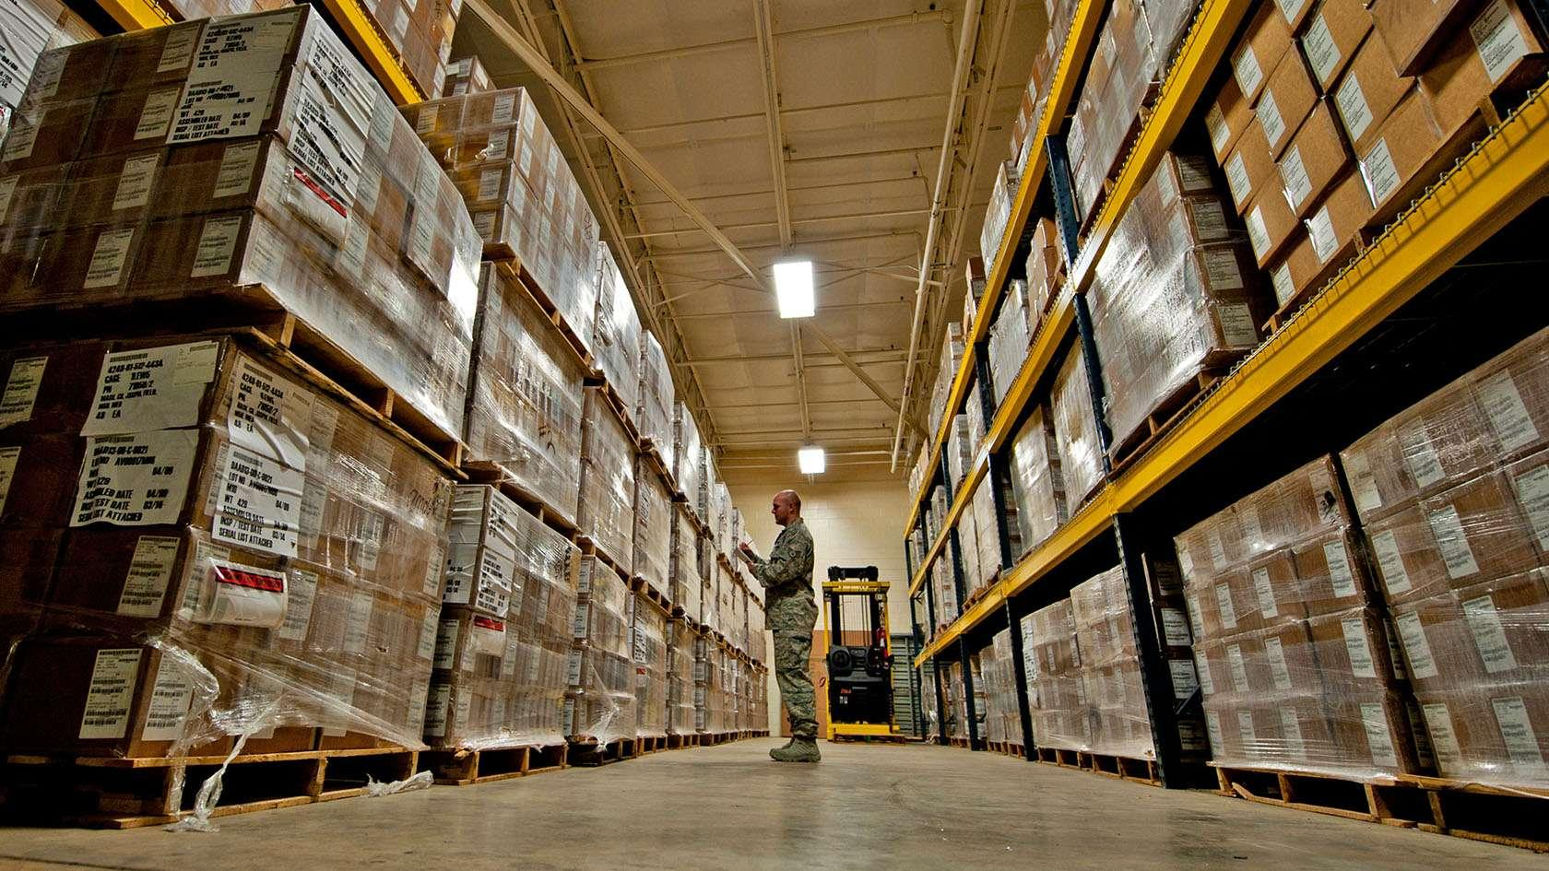
Ventury
An AI powered Inventory management assistant.

Slide 3
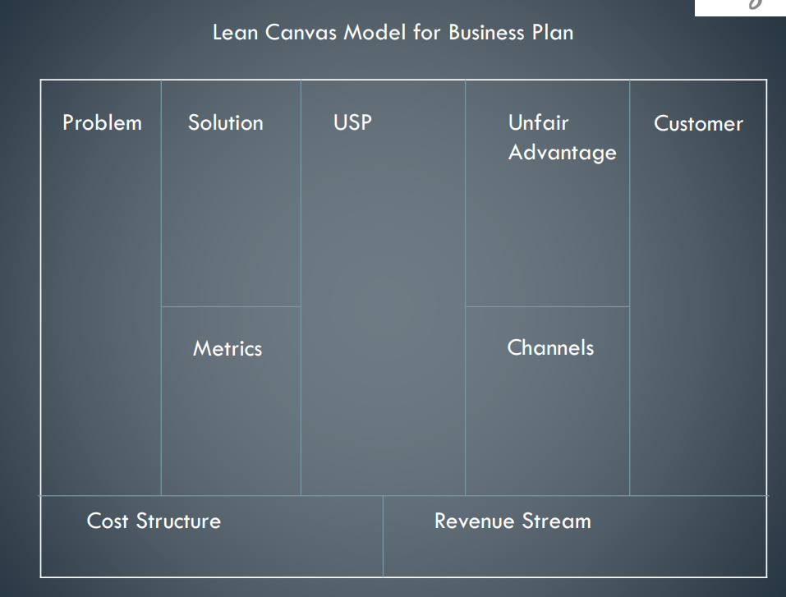
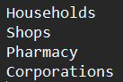
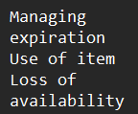
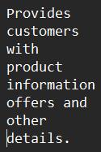
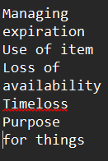
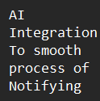
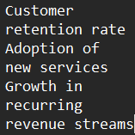
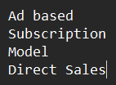
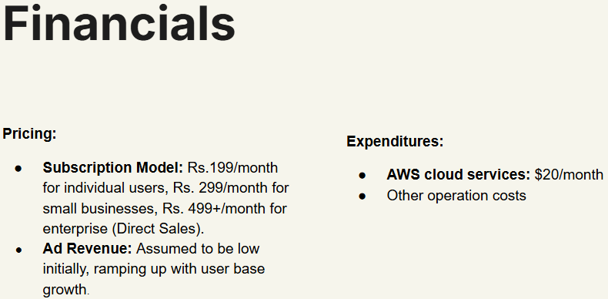


Slide 4
Company Purpose
To enhance lifestyle and industry conditions using AI and software automation.

Slide 5
Problem
Mismanagement of goods & services causing financial loss
Managing expiration
Use of item
Loss of availability
People in households generally forget the expiry dates of their pantry goods and waste supplies.
People often get confused when an item’s expiry date gets closer.
People forget which brand products they bought and liked when they buy same product of different brands.
Timeloss
Purpose for things
Specifications
No one has time to go through details of each and every product they have in their inventory or search in database everyday.
Most people often don’t know which item to use and where or if it is good to keep or to dispose it off.
People like brand specialisation but forget it while going through daily activities

Slide 6
Solution
AI powered inventory management assistant.
Managing expiration
Use of item
Loss of availability
Suggest various ways the item can be used in household.
People can specify which brands they like and from where they buy to get sale and discount notifications.
Sends expiration notifications through various different channels.
Timeloss
AR integration
Specialisation
Automatically retrieves and sends notifications accordingly.
You can now add your clothes and other accessories onto yourself that you have stored in your inventory.
It will note down how many times customer bought the product and how many times used or thrown due to not liking it.

Slide 7


Unique Selling Point
It uses AI algorithms such as object detection, bar code scanning and text inputs such as OCR to add correct entries to database.
Intuitive UI design makes the software appealing and satisfying to use.
This system is tailored into various designs each specifically for the industry it serves.
Provides customers with company information offers and other details.

Slide 8


Why now?
AI and automation market is now on the rise with new models being released everyday for different computational purposes.
Now is the best opportunity to make use of these pieces of techniques and software,
To provide the comfort people are looking for in today’s time and future proofing for the future generation.
Everyone in IT industry is talking about AI.

Slide 9
Target
Customer
Pharmaceutical industries and all industries with warehouses. Households as well as office break rooms and vending machines. Supermarkets as well as grocery shops all around the world.
Industrial management systems such as in hotels and restaurants where inventory management is crucial and can’t be avoided.
Warehouses that store food supplies and canteens.

Slide 10
COMPETITION & BARRIER TO ENTRY
There is a great amount of power struggle in between AI companies as their AI solutions are not optimised. As technology evolves more and more techniques are being used for optimisation.
The current AI solutions are small scale as AI implementation always requires human intervention.
Competitors:-
OpenAI
Salesforce Einstein
C3.ai
Makovate
H2O.ai

Slide 11
Product/Service
A software application that can be used on mobile and computers which uses the system resources to automate inventory management.
It scans barcode as well as the object or the bill to add items to the inventory.
It automatically creates a shopping list.
It remembers the brands as well as the expiry date with a full customer review system.
It also remember from where each item has been bought.
You can upload your closet and use AR vision to check which clothes suit you and which do not.
You can keep track of medicines and where they are stored and their expiry.

Slide 12
Product Lineup
AR Closet
Brand & Expiry Management
Local Storage and Offline Functionality
This software automates inventory management across mobile, desktop, and web platforms, using barcode/object scanning, AR for closet visualization, and expiry tracking. Key features include shopping list generation, brand/store memory, customer reviews, and medicine management. The architecture leverages cloud sync, AI/ML for recognition, and AR engines (ARKit/ARCore). Intellectual property includes patents for scanning/AR combos, trademarks, and proprietary AI models.
Ventury
Smart Shopping List
Automatically generates
Medicine Tracking

Slide 13
Business Model
Ad based
Subscription Model
Direct Sales
We will provide fully built integrated systems with our software to high-value company customers with big inventory management required
We will advertise the discounts and offers on the products needed or products that a customer busy regularly.
We will charge subscription for the use of our services

Slide 14
Team
Software & deployment
Ai & ML expert (Myself)
Business dealing
ThindTech
Co-Founders & Management
Hardware Manufacturing
(Advisor)
Finance
Marketing

Slide 15
Financials
Pricing:
Subscription Model: Rs.199/month for individual users, Rs. 299/month for small businesses, Rs. 499+/month for enterprise (Direct Sales).
Ad Revenue: Assumed to be low initially, ramping up with user base growth.
Expenditures:
AWS cloud services: $20/month
Other operation costs

Slide 16
Thank You

